Slide 1
Cyberbullying concept
A concept on cyberbullying
By Huub van Holsteijn

Slide 2
Main answered questions
Who
What
When
Why
How?

Slide 3
Our team
Arturo, Huub, Hyeon, Leah, Liam, Min
Scrum - 2 weeks
Scrum goals
Defining the concept (Setting requirements)
Creating a story
Class diagrams
User experience design
Testing
Profits?
Different scrum roles every sprint
Organize plannings

Slide 4
A game on cyberbullying
The gaming concepts
Main concept: Cyberbullying
Slander
Asking adults
Et cetera
Role playing game (RPG)
Story driven
Creating your own story
Trying not to be outdated

Slide 5
Why a Role Playing Game
A RPG
++ | Advantages | ++
Persons can relate to a story/character
Realistic or Fictional
-- | Disadvantages | --
Creating Artificial Intelligence (AI) is complex
++ | Advantages | ++
Creativity

Slide 6
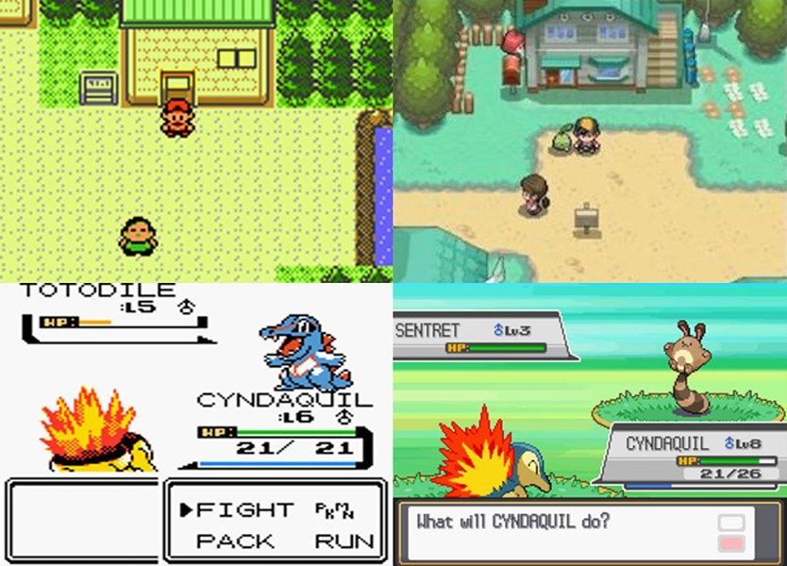
Sample RPG

Slide 7
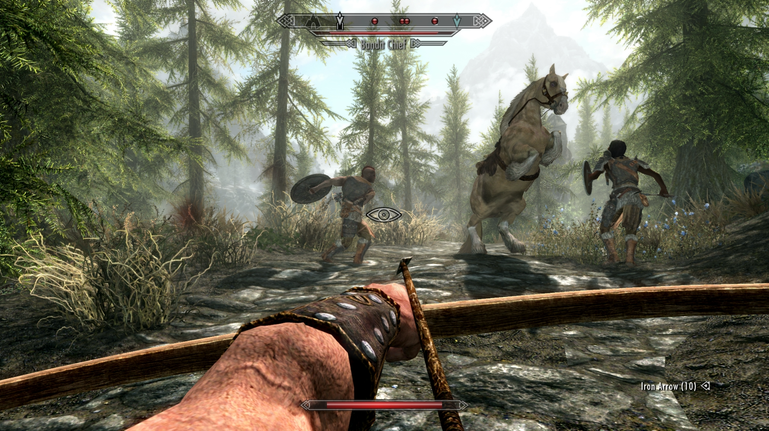
The Elder Scrolls V: Skyrim

Slide 8
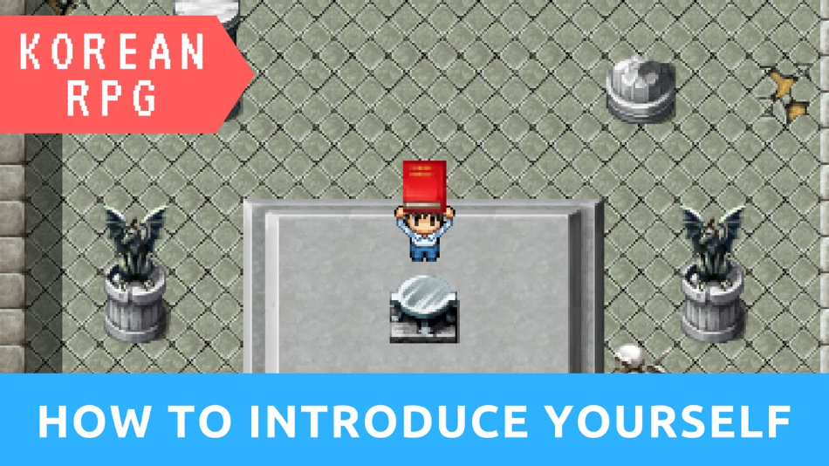
Korean RPG
A language learning game for the Korean language source: https://www.youtube.com/watch?v=5EAr3o7Qgu8

Slide 9
When do we want to be finished
Coming 10 weeks YO!
(or ASAP)

Slide 10
How is going to be made
Gaming engines:
Unity Javascript:
Javascript, C#
Almost any platform you can think of
Drawback: free under 10k
Three.js
Javascript
MonoGame
Drawback:Windows platforms and mobile only
Blender
Python

Slide 11
The end!

